Slide 1
No Vein No Gain: Modeling Angiogenesis
Group 13
Fabian Ivulic, Costanza D’Ercole,
Noa Roebersen, and Sophie Engels

Slide 2
01
Background
Modeling Angiogenesis:
Understanding Tumor Growth through VEGF Dynamics

Slide 3

What to examine?
Angiogenesis: the growth of blood vessels.
Scale-invariance
Power law
Various control parameters

Slide 4
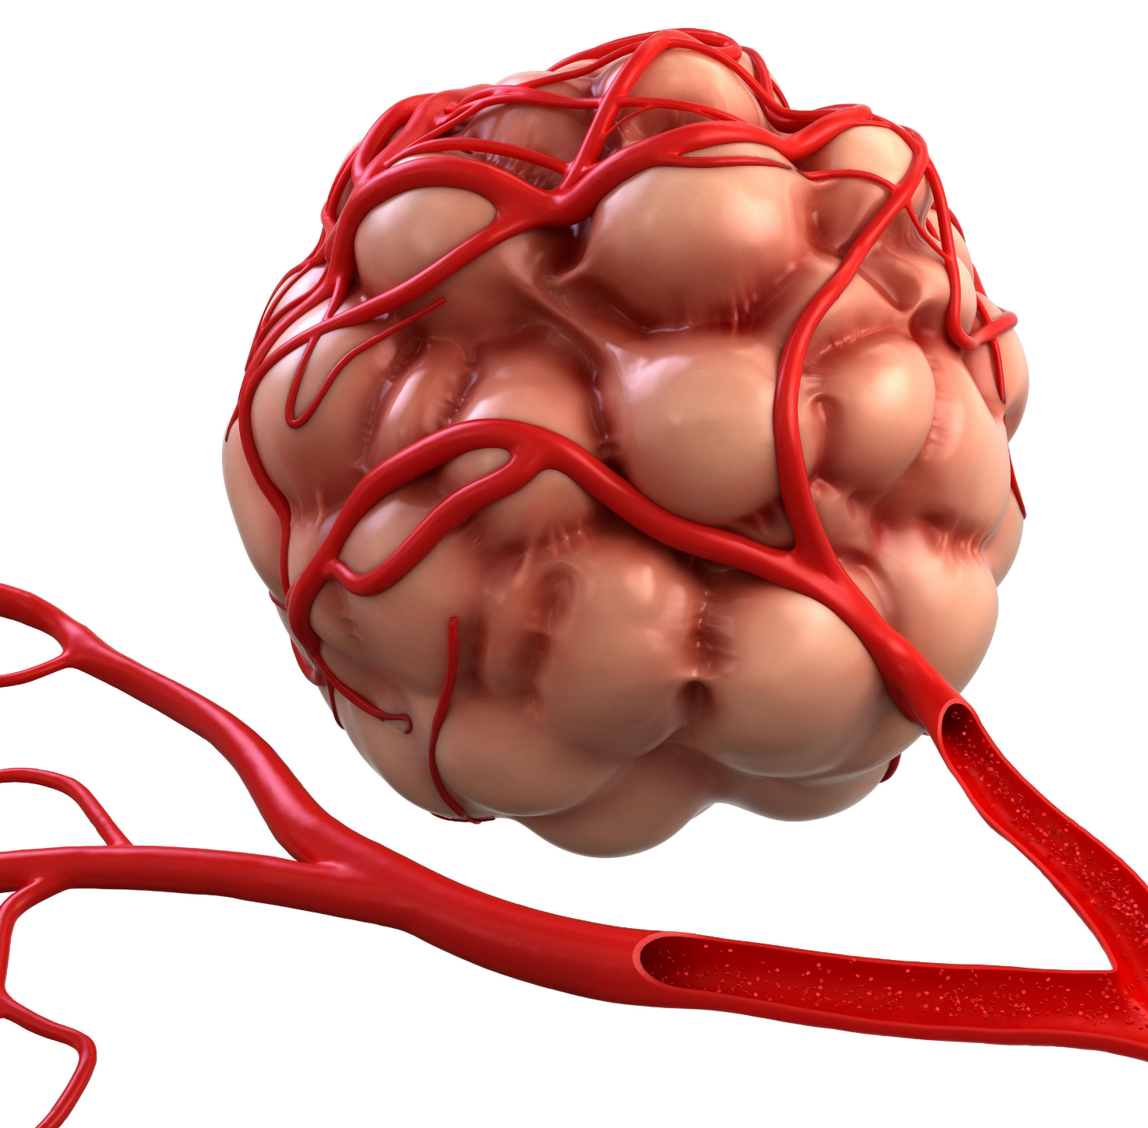
VEGF and Tumor Growth
Vascular endothelial growth factor (VEGF)
Signaling molecule
VEGF-based bias
Eventually tumor growth

Slide 5
02
Model Design and Implementation
Modeling Angiogenesis:
Understanding Tumor Growth through VEGF Dynamics

Slide 6
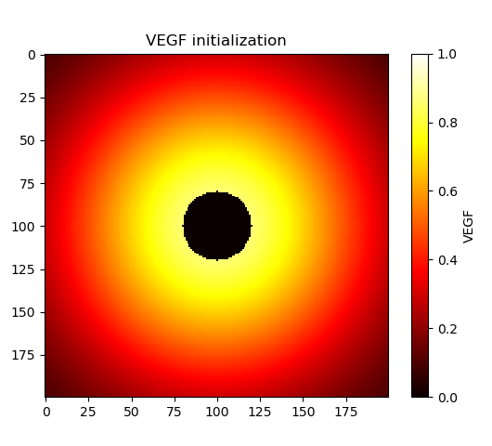
Initialization
Initial VEGF values on background grid

Slide 7
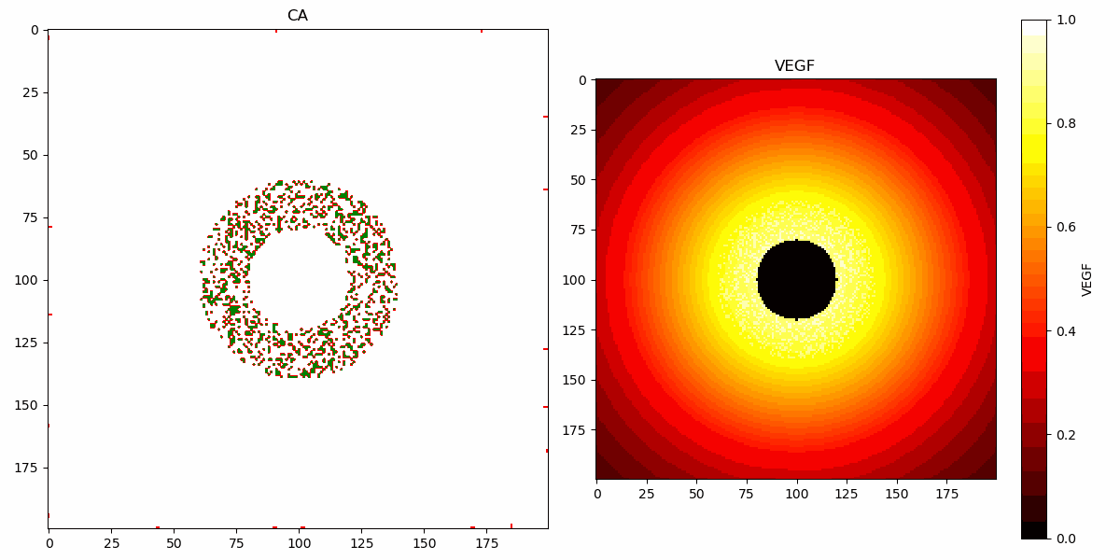
The Model
Notes:
After initializing the VEGF background, we initialize the cells that indicate where the tumor is growing, we call these proliferating tumor cells, indicated by green in the gif. We initialize these as randomly placed cells within an annulus with density 0.3. These cells increase the VEGF locally by 0.1.
Our simulation consists of two phases
We begin the first phase by spawning 5 blood vessels on each edge of the grid. The vessels grow by following a biased random walk. The growing of a blood vessel lowers the VEGF in their neighborhood
The tumor cells are static in this phase
This vessel growth phase lasts until we reach the breakpoint at 350 steps, around when the vessels reached the tumor annulus and have grown into it a bit
After the breakpoint, we reach the co-evolving phase.
The vessels keep growing, but the tumor cells will start to interact with the blood vessels. The tumor cells can either stay static, die in the absence of blood supply, or multiply when there is a enough blood supply

Slide 8
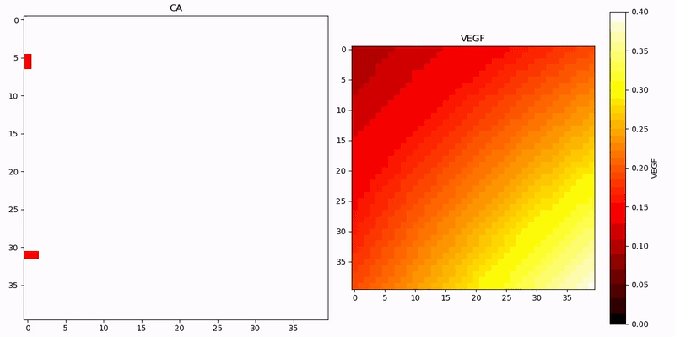
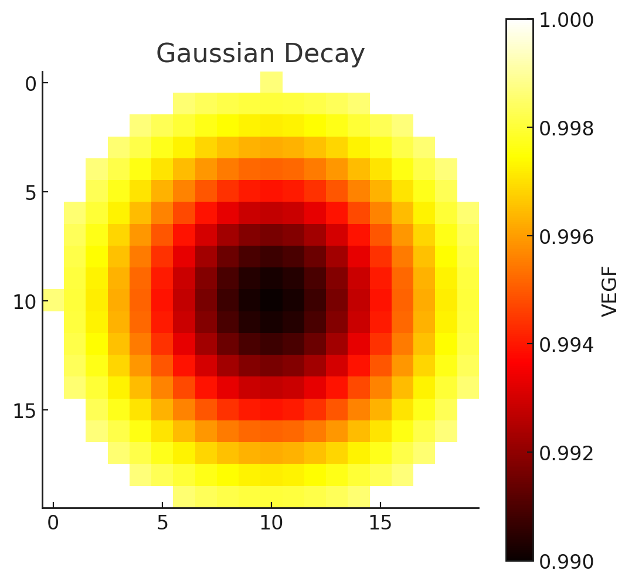
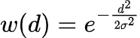
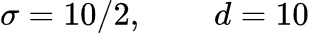
Vessel Growth and Gaussian VEGF Decay
Probability of growing to neighbor cell x,y
P(x,y) = U(0,1) * (1 - bias_factor) + VEGF(x,y) * bias_factor
VEGF(x,y) = max(0, VEGF(x,y) * (1 - w(d) * 0.01)
Notes:
We model the growth of the blood vessels by a random walk biased by the VEGF background. If the bias factor is set to zero, the probability of growing to any neighbor is completely random, and if we choose a bias term of 1, the blood vessel will grow completely biased. We show a growing vessel zoomed in for the first 150 timesteps
As the bloodvessel grows, the VEGF decays by a gaussian weight function. We define a neighborhood of size d=10 and a gaussian decay strength of 10 / 2. The decay factor stays constant at 0.01
The decay around a single cell is shown in the bottom figure
On the right, we can clearly see the background VEGF decaying where the bloodvessel grows.

Slide 9
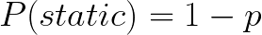
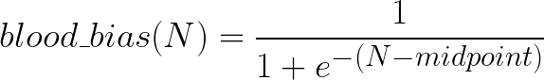
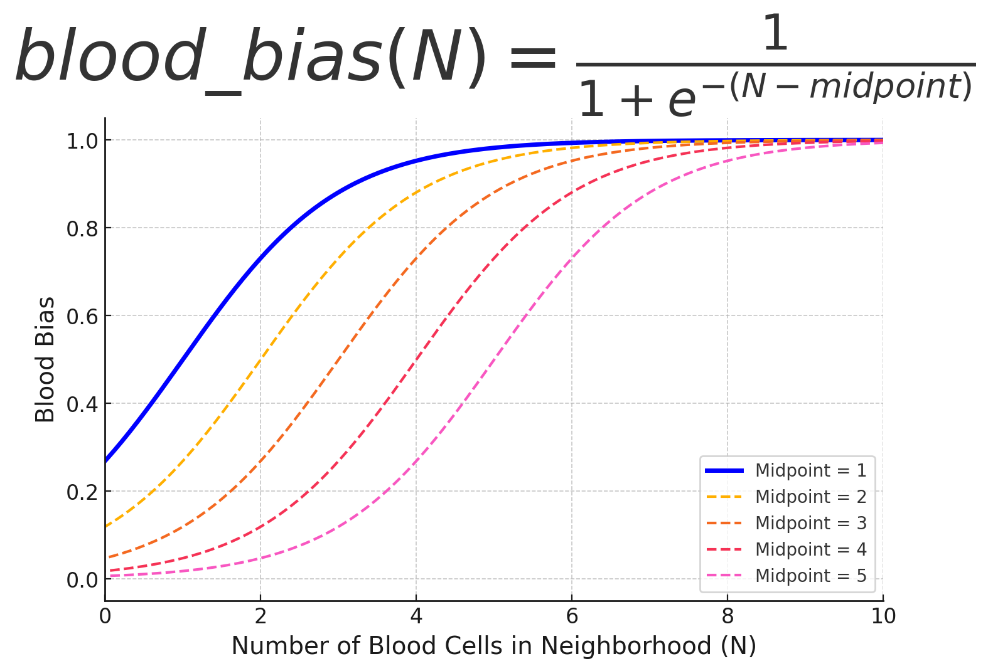
Growth and Death of Proliferating
Tumor Cells
Von Neumann Neighborhood
(r = 2)
Notes:
When we reach the breakpoint, the interaction between the blood vessels and tumor cancer cells comes into play.
We model this by first defining a parameter p, where p is the probability of something happening and 1-p the probability of the tumor cell staying static.
Then we model the probability of either dying or multiplying with a sigmoid function based on the number of blood cells in the neighborhood, we call this the blood bias.
For the sigmoid function we choose a midpoint at 1 for the majority of our runs, shown in blue. Meaning, when there is 1 blood cell in its von Neumann neighborhood of radius 2, the tumor cell has equal probability of dying and multiplying. The probability of dying goes to zero as the number of blood cells in its neighborhood approaches 5.

Slide 10
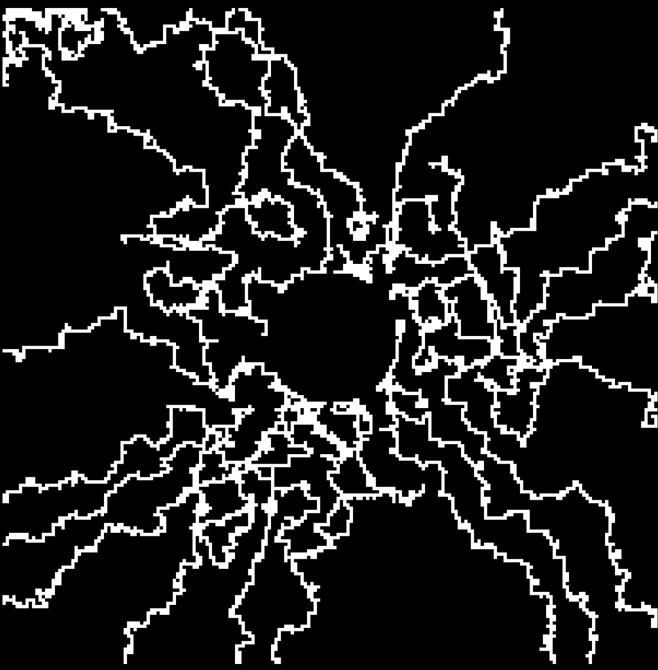
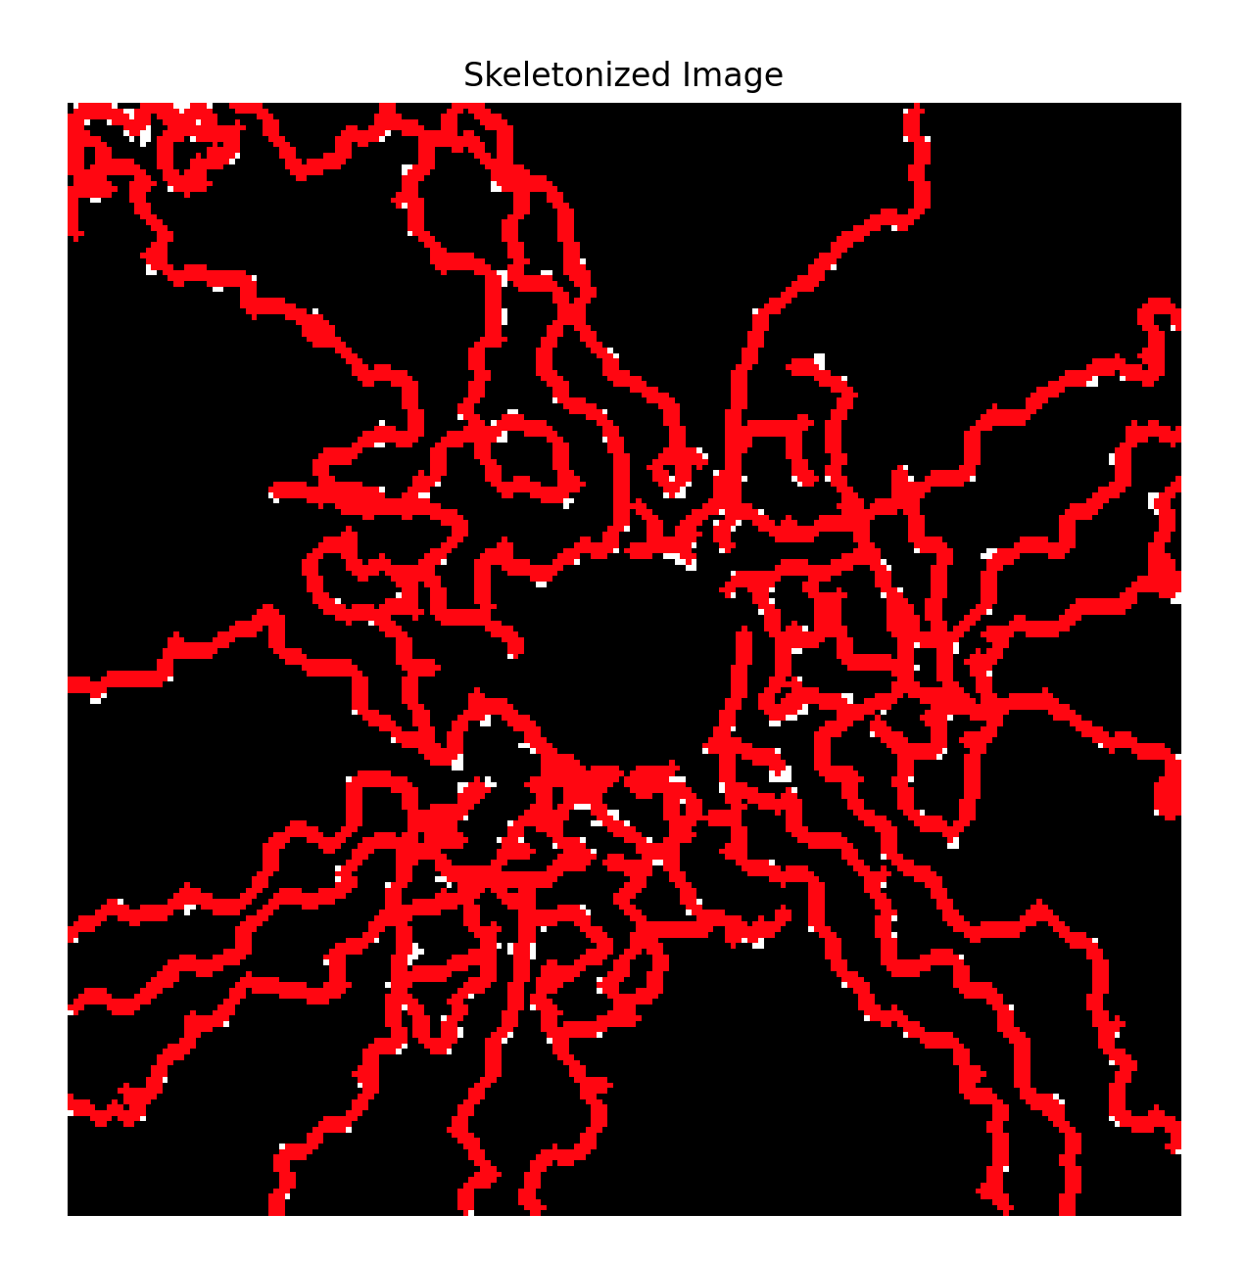
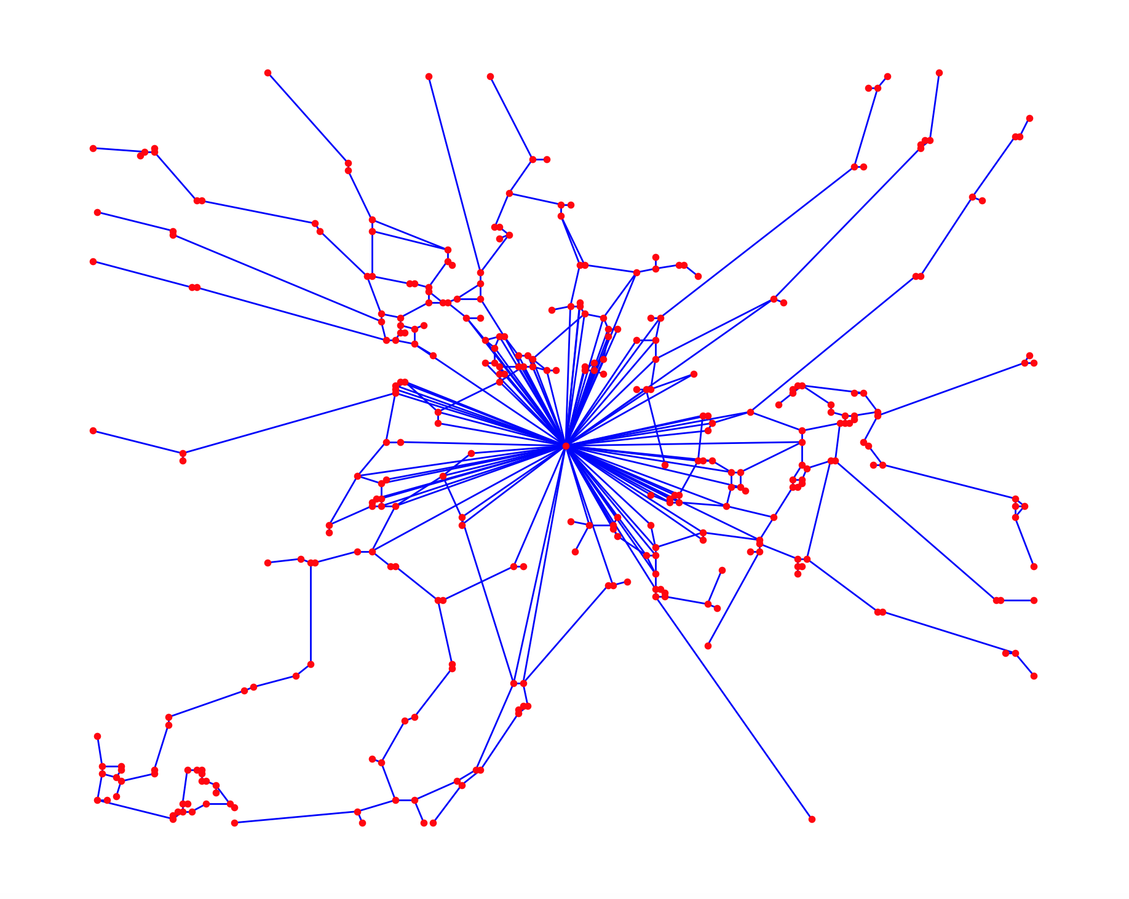
Image Processing and
Vessel Network Creation
Binary Image
Skeletonized Image
Estimated Network
Notes:
To investigate the behavior of the bloodvessel network we use an image processing library in python called Skan, built for analyzing skeletonized images.
We take the grid consisting of blood vessel cells only, and skeletonize it by creating 1-pixel long lines along the blood vessels.
This skeletonized imagine is then transformed into a network by that same library. Where nodes are identified as junctions or endpoints.
The central node represents the tumor. If a node has a tumor cell in its neighborhood, it becomes attached to the static tumor (it provides nutrients). This is represented as an edge connected to the central tumor node.
Network abstraction is useful in studying clustering and connectedness within the vessel network and how this can change in the presence of tumor.

Slide 11
03
Results: Tumor and Vessel Growth Analysis

Slide 12
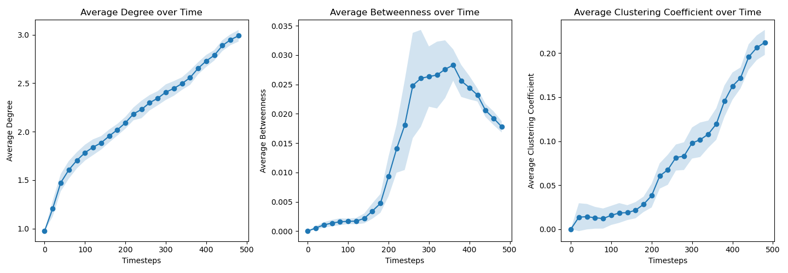
Network Measures over Time
breakpoint
Notes:
We can explore how the blood vessel network evolves over time.
First, we notice that average degree increases over time, relatively linearly. As the network grows, it becomes more interconnected (more branching) as a result of the angiogenesis. This improves nutrient delivery to the tumor.
Next, for average clustering coefficient, it’s relatively low for a while when the network is forming. Here we assume there is more of a tree-like structure while the growth is prioritizing reaching the growth hormone and delivering nutrients to the tumor. However, once it gets there (~180 time steps), we see a rapid increase in average clustering coefficient, which indicates the presence of more interconnected clusters (this reduces the average path length for blood to travel).
As a result of this, certain nodes become less important for blood circulation, reducing average betweenness. Once the simulation has hit the breakpoint (350 time steps), the proliferating cells begin to cluster as well rather than being uniformly spaced around the center, so the connections of the vessel network to the central tumor node are more sparse, reducing its dependency on the central tumor node.

Slide 13
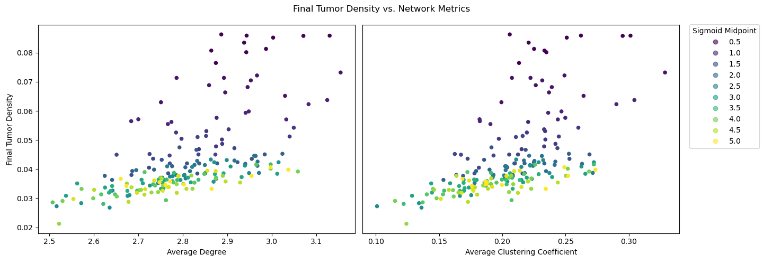
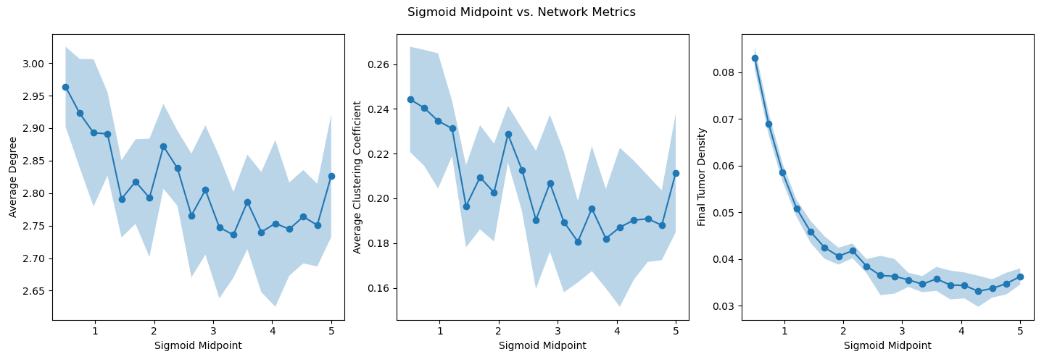
Tumor density VS Network Metrics
Sigmoid Midpoint VS Network Metrics
Varying Sigmoid Midpoint
Notes:
Increasing the sigmoid midpoint moves the steep curve increase to the right, effectively increasing the probability of death and decreasing the probability of growth.
As we change the sigmoid midpoint, probability of death increases. This results in a lower tumor density, but has little effect on the blood vessel network statistics.
By the time the tumor begins to proliferate and die, the blood vessel network is established when any tumor cell arrives. Whether or not they die should not affect the vascular network on this timescale.

Slide 14
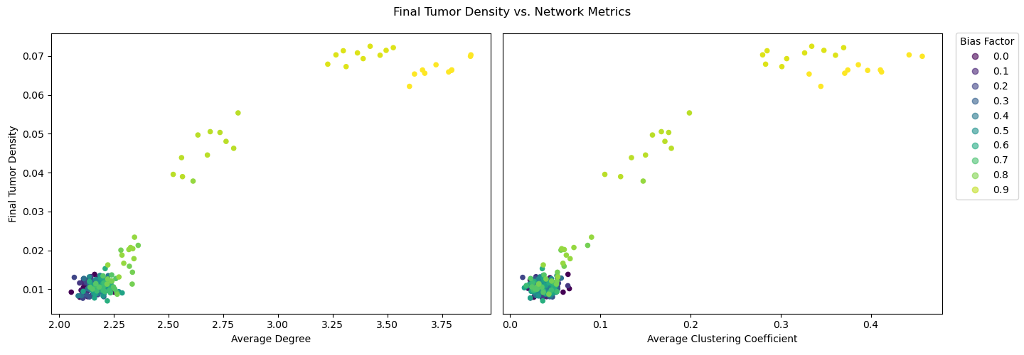
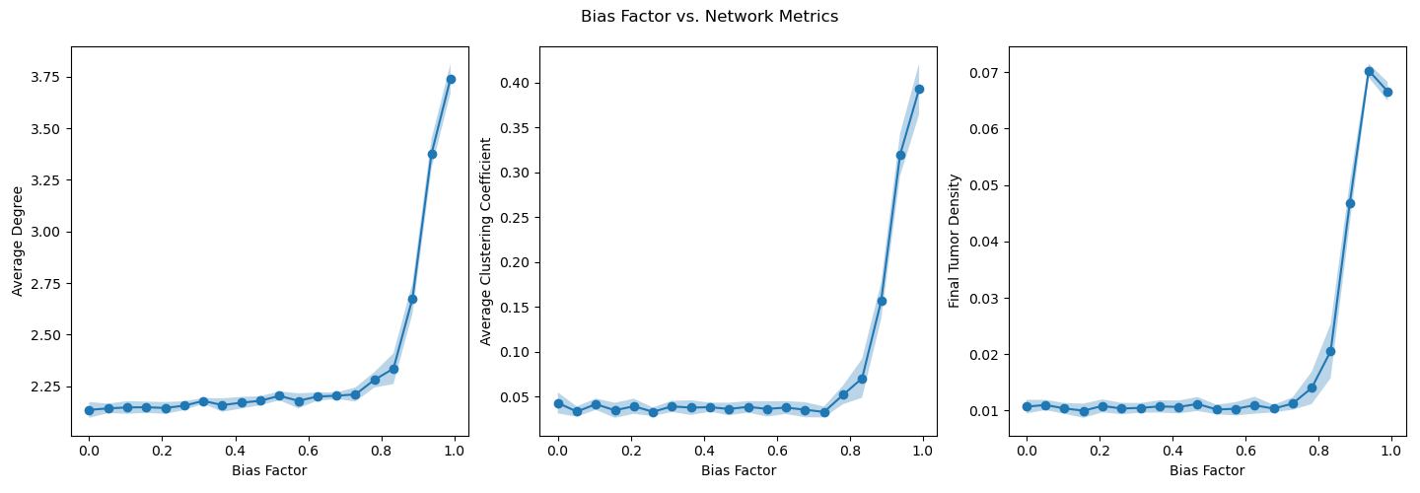
Tumor density VS Network metrics
Bias factor VS Network Metrics
Varying Bias Factor
Notes:
Bias factor has some unusual results. Since it controls the effect of VEGF on vessel growth. At low bias factor values, the vessels grow relatively randomly (they don’t care about their direction). However, there does seem to be a sort of tipping point, where average degree, clustering coefficient, and tumor density suddenly become extremely high. This would suggest that reducing the dependency of angiogenesis on VEGF and growth hormones will significantly reduce tumor growth as well, either by reducing VEGF secretion by the tumor itself or adding other chemicals that the vessel endothelial cells can take up in its place.

Slide 15
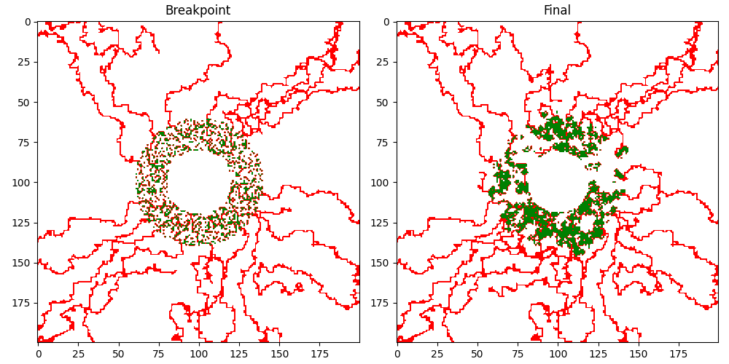
Tumor and Vessel Growth:
clustering behavior over time
(Timestep 350)
Notes:
This figure shows a comparison of the tumor and vessel structures at a critical breakpoint and at the end of the simulation. We can visually observe the formation of distinct clusters in both tumor and vessel networks, indicating localized growth patterns.

Slide 16
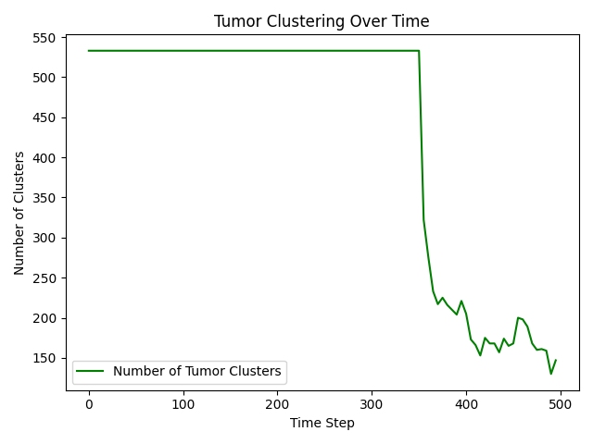
Tumor Growth:
clustering behavior over time
Minimum cluster size = 1
breakpoint
Before the breakpoint, many small clusters exist.
After the breakpoint, clusters start to merge.
Notes:
Tumor clusters: Initially, many small clusters exist, but as the simulation progresses, clusters merge, leading to a sharp decline in their total count.

Slide 17
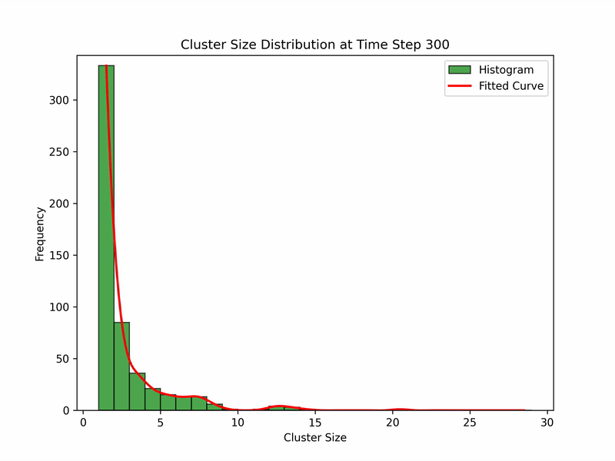
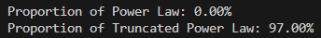
Tumor Growth:
clustering behavior over time
Power law?
Truncated power law?
100 simulations.
10 combined datasets per simulation.
Notes:
We observe a power law behavior in the plot, and the tests confirms this hypothesis.

Slide 18
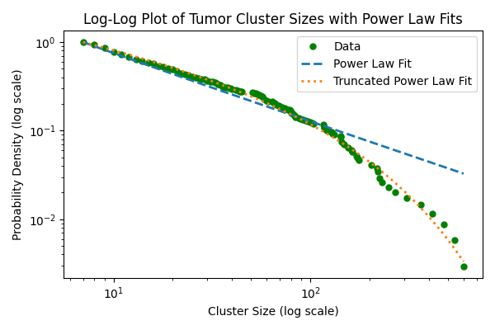
Tumor Growth:
clustering behavior over time
Tumor cells clusters follow a truncated power law distribution.
Truncated Power law VS | R | p-value
Exponential | 5.56 | <<0.05
Lognormal | 3.30 | <<0.05
Power law | 3.99 | <<0.05
Notes:
Truncated power law can be caused by various factors: nutrient supply, space constraints (clusters cannot grow infinitely in a finite environment!).

Slide 19
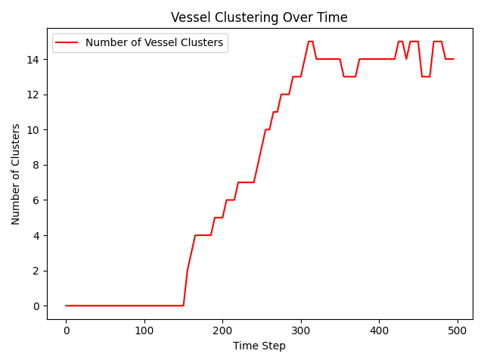
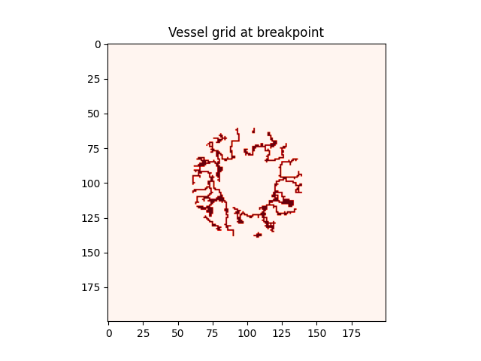
Vessel Growth:
clustering behavior over time
Study the cluster distribution of vessel cells.
Restrict the view only in the tumor area.
Random angiogenesis
Vessels in tumor area at breakpoint
Connections for tumor supply
Is the tumor clusters’ power law distribution influenced by the same distribution in the vessels?
Notes:
Early vessels grow chaotically, forming disconnected clusters. At the breakpoint, clusters start to form due to: increased oxygen demand from the tumor → formation of large vessel clusters to support tumor growth.

Slide 20
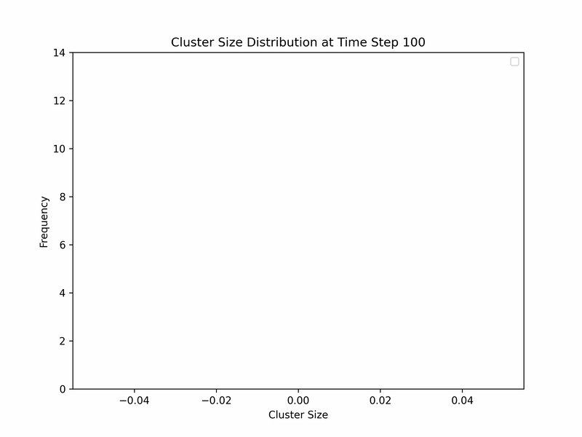
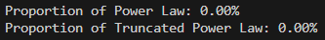
Vessel Growth:
clustering behavior over time
100 simulations.
10 combined datasets per simulation.
Vessel cluster sizes do not follow a power law distribution around the tumor.

Slide 21
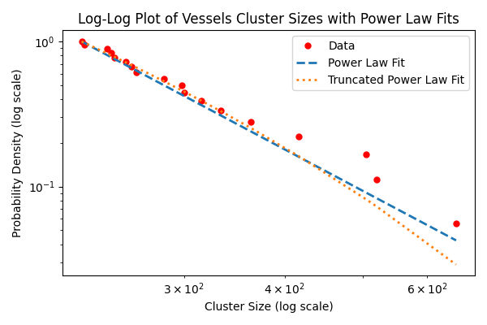
Vessel Growth:
clustering behavior over time
Power law VS | R | p-value
Exponential | 0.04 | 0.97
Lognormal | -0.35 | 0.73
Truncated power law | -0.47 | 0.55
Truncated Power law VS | R | p-value
Exponential | 0.45 | 0.65
Lognormal | 0.89 | 0.37
Power law | 0.47 | 0.55
Example of vessel cluster sizes fit. All p-values >> 0.05.
Notes:
Although the log-log plot suggests a power law-like trend, statistical tests (including 100 simulations using the powerlaw package) provide no significant evidence to support a power law or truncated power law distribution. This suggests that while vessel clustering exhibits heavy-tailed behavior, it is better described by an alternative distribution

Slide 22
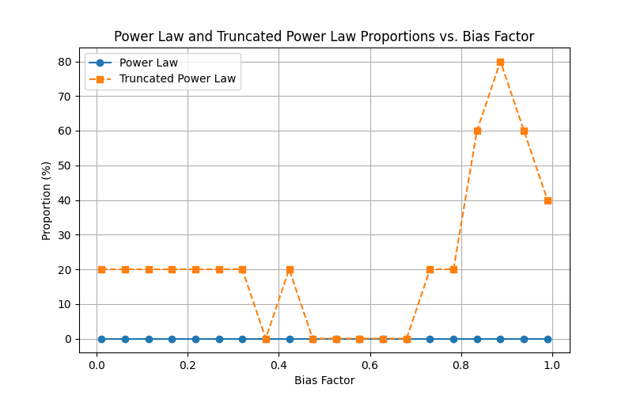
Bias Factor and Tumor Clusters
Notes:
Low bias factor → model is more random
Higher bias factor → vessels follow the VEGF more strictly

Slide 23
Thank you!

Slide 24
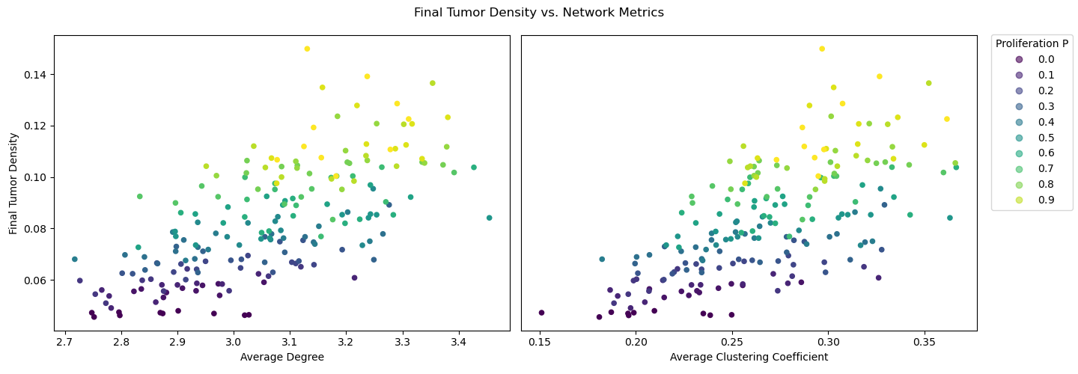
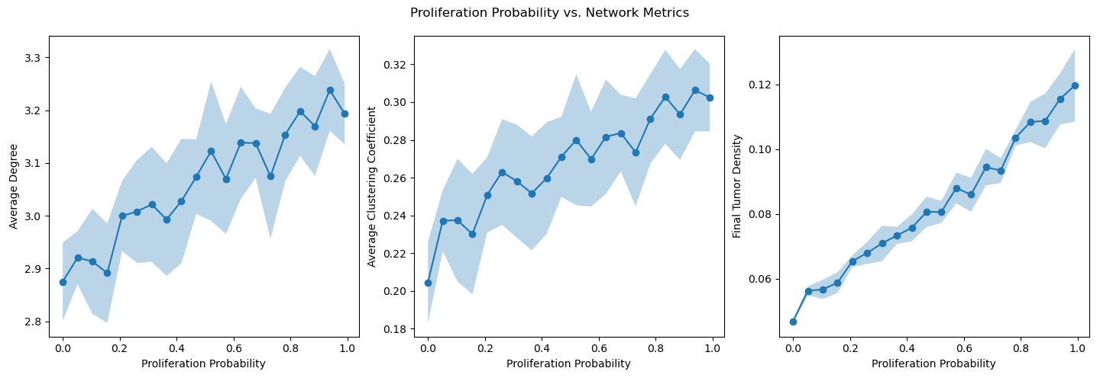
Appendix 1
Proliferation Probability VS Network Metrics
Varying the probability of tumor cell growth/death
Notes:
We wanted to investigate the relationships between network statistics of the vessel network and the tumor growth, specifically the tumor density.
Here, we varied the proliferation probability (i.e. that the tumor will grow or die). We notice, across all experiments, that there is a positive relationship between average degree and tumor density and average clustering coefficient and tumor density. This makes sense, since more interconnected and clustered vessel networks can better support tumor growth.
As the probability of growth/death or dynamics in tumor growth increases, we also notice that tumor density increases and graph interconnectedness and clustering increases. This suggests that the more a tumor evolves, the more it will thrive, i.e. halting tumor growth will significantly improve the outcome.

Slide 25
Gaussian Decay of VEGF due to Vessel Growth
decay_factor = 0.99
Notes:
We model the decay of the VEGF due to the growth of the blood vessels by a gaussian function. We define a neighborhood d of 10 and an sigma of 10/2. The decay factor stays constant at 0.99.
The decay around a single cell is shown in the top left figure
For clarity we added a zoomed in version of the first 200 steps of the left corner. Here we can clearly see the background VEGF decaying where the bloodvessel grows.

